Slide 1
Lecture 16 & 17 Chapter 5
Number Representation and Arithmetic Circuits
Chapter Objectives
In this chapter you will learn about:
• Representation of numbers in computers
• Circuits used to perform arithmetic operations

Slide 2
Unsigned Integers
Numbers that are positive only are called unsigned numbers, and numbers that can also be negative are called signed numbers.
Representation of numbers that include a radix point => real numbers
In the familiar decimal system:
a number consists of digits that have 10 possible values from 0 to 9.
each digit represents a multiple of a power of 10.
For example, the number 8547 represents 8 × 10³ + 5 × 10² + 4 × 10¹ + 7 × 10⁰.
But, we do not normally write the powers of 10 with the number, because they are implied by the positions of the digits.

Slide 3
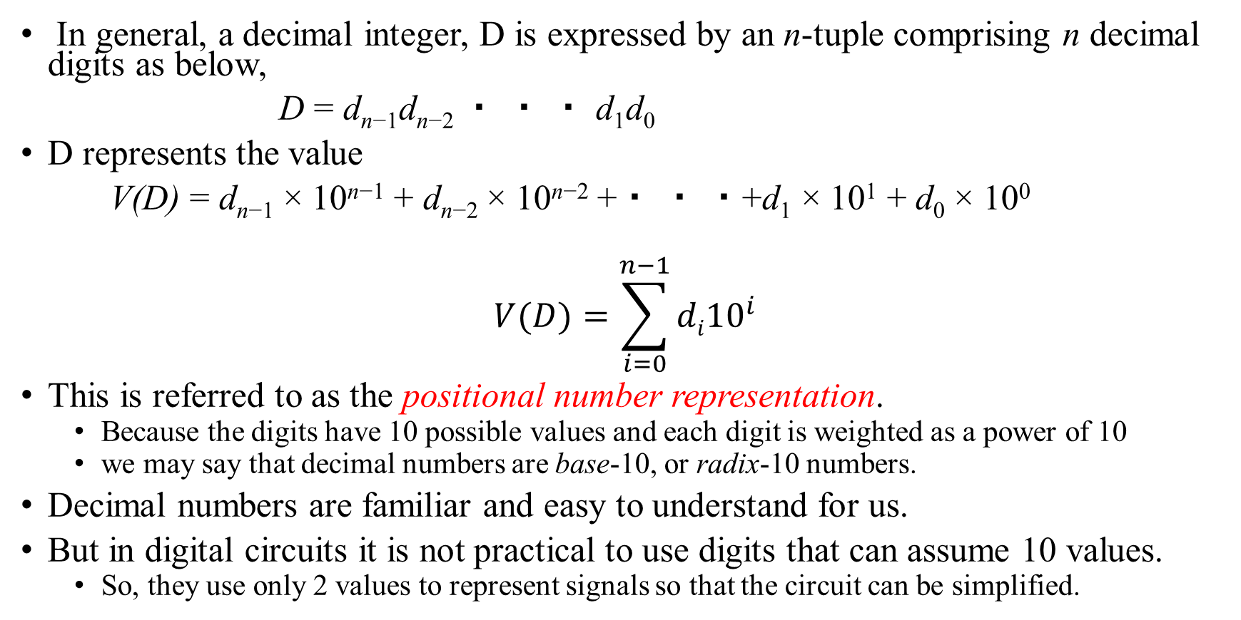
Positional Number Representation
In general, a decimal integer, D is expressed by an n-tuple comprising n decimal digits as below,
D = d_{n−1}d_{n−2} ・ ・ ・ d₁d₀
D represents the value
V(D) = d_{n−1} × 10^{n−1} + d_{n−2} × 10^{n−2} +・ ・ ・+d₁ × 10¹ + d₀ × 10⁰
$$V(D)=\sum_{i=0}^{n−1}{di{10}^{i}}$$
This is referred to as the positional number representation.
Because the digits have 10 possible values and each digit is weighted as a power of 10
we may say that decimal numbers are base-10, or radix-10 numbers.
Decimal numbers are familiar and easy to understand for us.
But in digital circuits it is not practical to use digits that can assume 10 values.
So, they use only 2 values to represent signals so that the circuit can be simplified.

Slide 4
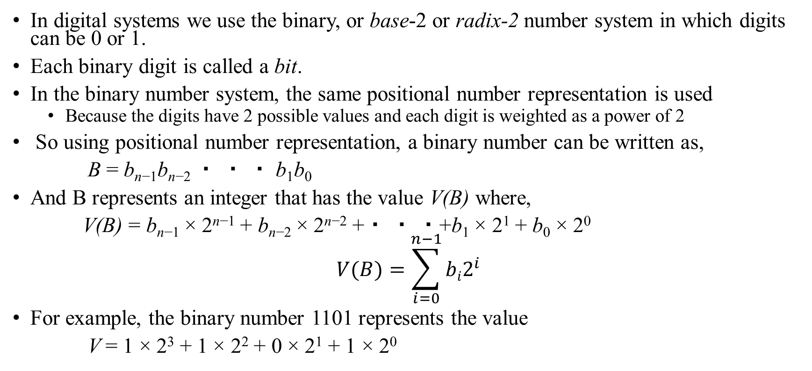
Binary Number System
In digital systems we use the binary, or base-2 or radix-2 number system in which digits can be 0 or 1.
Each binary digit is called a bit.
In the binary number system, the same positional number representation is used
Because the digits have 2 possible values and each digit is weighted as a power of 2
So using positional number representation, a binary number can be written as,
B = b_{n−1}b_{n−2} ・ ・ ・ b₁b₀
And B represents an integer that has the value V(B) where,
V(B) = b_{n−1} × 2^{n−1} + b_{n−2} × 2^{n−2} +・ ・ ・+b₁ × 2¹ + b₀ × 2⁰
$$V(B)=\sum_{i=0}^{n−1}{bi2^{i}}$$
For example, the binary number 1101 represents the value
V = 1 × 2³ + 1 × 2² + 0 × 2¹ + 1 × 2⁰

Slide 5
Contd..
We can indicate the radix as a subscript when there is potential for confusion.
So, 1101 is a base-2 number, and we shall write it as (1101)₂.
Evaluating the preceding expression for V
=> V = 1 × 2³ + 1 × 2² + 0 × 2¹ + 1 × 2⁰ = 8 + 4 + 1 = 13.
Hence (1101)₂ = (13)₁₀
The range of integers that can be represented by a binary number depends on the number of bits used.
For example, with four bits the largest number is (1111)₂ = (15)₁₀.
An example of a larger number is (10110111)₂ = (183)₁₀.
In general, using n bits allows representation of integers in the range 0 to 2^{n −1}

Slide 6
Contd..
In a binary number the right-most bit is usually referred to as the least-significant bit (LSB).
The left-most bit of an unsigned integer, which has the highest power of 2 associated with it, is called the most-significant bit (MSB).
In digital systems it is often convenient to consider several bits together as a group.
A group of four bits is called a nibble
A group of eight bits is called a byte.

Slide 7
Conversion between Decimal and Binary Numbers
A binary number is converted into a decimal number simply by applying the previous equation and evaluating it using decimal arithmetic.
Ex. (1110)₂ = (1 × 2³ + 1 × 2² + 1 × 2¹ + 0 × 2⁰)₁₀ = (8 + 4 + 2)₁₀ = (14)₁₀
Converting a decimal number into a binary number is not quite as straightforward.
The conversion can be performed by successively dividing the decimal number by 2 as follows.
Suppose that a decimal number D = d_{k−1} ・ ・ ・ d₁d₀, with a value V, is to be converted into a binary number B = b_{n−1} ・ ・ ・ b₂b₁b₀.
Thus V = b_{n−1} × 2^{n−1} +・ ・ ・+b₂ × 2² + b₁ × 2¹ + b₀
If we divide V by 2, the result is
V/2= b_{n−1} × 2^{n−2} +・ ・ ・+b₂ × 2¹ + b₁ + b₀/2
The quotient of this integer division is b_{n−1} ×2^{n−2} +・ ・ ・+b₂ ×2+b₁, and the remainder is b₀.

Slide 8
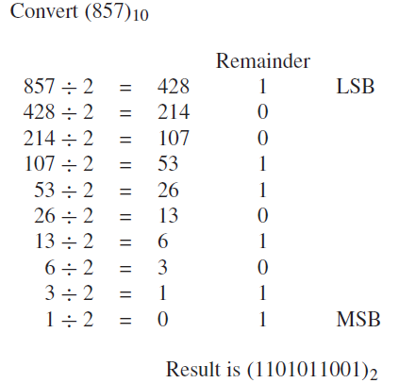
Contd..
The quotient of this integer division is b_{n−1} ×2^{n−2} +・ ・ ・+b₂ ×2+b₁, and the remainder is b₀.
If the remainder is 0, then b₀ = 0; if it is 1, then b₀ = 1.
We can see that the quotient is just another binary number but with n − 1 bits rather than n bits.
Now, dividing the quotient by 2 yields the remainder b₁ and the new quotient is b_{n−1} × 2^{n−3} +・ ・ ・+b₂
Continuing the process of dividing the new quotient by 2, and determining one bit in each step, will produce all bits of the binary number.
The process continues until the quotient becomes 0.
The Figure illustrates the conversion process, using the example (857)₁₀ = (1101011001)₂.
Note that the least-significant bit (LSB) is generated first and the most significant bit (MSB) is generated last.

Slide 9
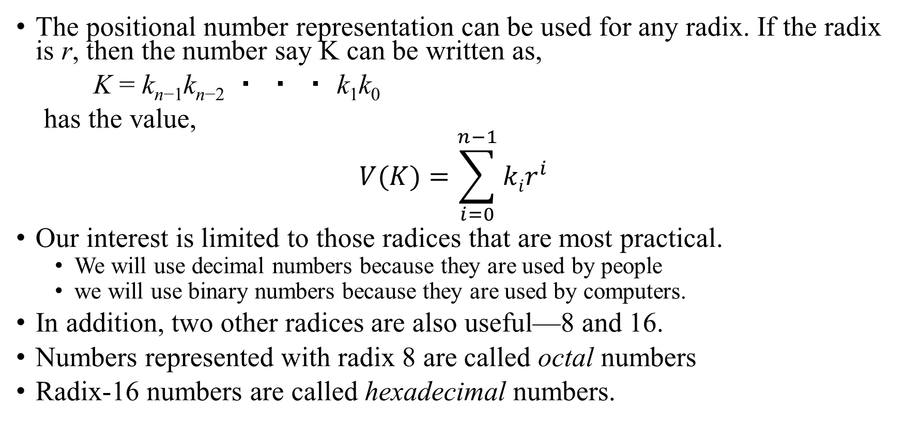
Octal and Hexadecimal Representations
The positional number representation can be used for any radix. If the radix is r, then the number say K can be written as,
K = k_{n−1}k_{n−2} ・ ・ ・ k₁k₀
has the value,
$$V(K)=\sum_{i=0}^{n−1}{kir^{i}}$$
Our interest is limited to those radices that are most practical.
We will use decimal numbers because they are used by people
we will use binary numbers because they are used by computers.
In addition, two other radices are also useful—8 and 16.
Numbers represented with radix 8 are called octal numbers
Radix-16 numbers are called hexadecimal numbers.

Slide 10
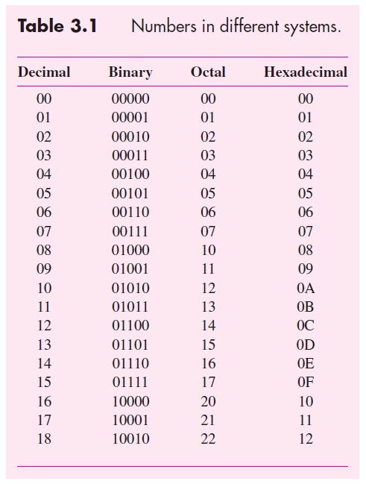
Contd..
In octal representation the digit values range from 0 to 7.
In hexadecimal representation (often abbreviated as hex), each digit can have one of 16 values.
The first ten are denoted the same as in the decimal system, namely, 0 to 9.
Digits that correspond to the decimal values 10, 11, 12, 13, 14, and 15 are denoted by the letters, A, B, C, D, E, and F
In computers the dominant number system is binary.
The reason for using the octal and hexadecimal systems is that they serve as a useful shorthand notation for binary numbers.

Slide 11

Conversion between Octal and Binary Numbers
One octal digit represents three binary bits.
Thus a binary number is converted into an octal number by:
Take as groups of three bits starting from LSB, and
Replacing each of the group with the corresponding octal digit.
For example, 101011010111 is converted as
which means that (101011010111)₂ = (5327)₈.

Slide 12

Contd..
If the number of bits is not a multiple of three, then we can add 0s to the left of the MSB.
For example, consider, (10111011)₂
Hence, (10111011)₂ = (273)₈
Conversion from octal to binary is just as straightforward
each octal digit is simply replaced by three bits that denote the same value.

Slide 13

Conversion between hexadecimal and Binary Numbers
A hexadecimal digit represents four bits.
Thus a binary number is converted into an hexadecimal number by:
Take as groups of four bits starting from LSB, and
Replacing each of the group with the corresponding hexadecimal digit.
For example, a 16-bit binary number, (1010111100100101)₂ can be represented as,
Hence, (1010111100100101)₂ = (AF25)₁₆

Slide 14

Contd..
Zeros are added to the left of the MSB if the number of bits is not a multiple of four.
For example, (1101101000)₂ = (368)₁₆ because of the grouping
Conversion from hexadecimal to binary involves straightforward substitution of each hex digit by four bits that denote the same value.
Binary numbers used in modern computers generally have 32 or 64 bits.
Written as binary n-tuples (sometimes called bit vectors)
Such numbers are awkward to deal with due to their length.
However, it is much simpler to deal with them in the form of 8- or 16-digit hex numbers.

Slide 15
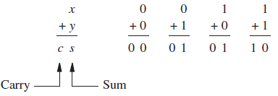
Addition of Unsigned Numbers
Because the arithmetic operations in a digital system usually involve binary numbers, we will now focus on circuits that use such numbers.
Binary addition is performed in the same way as decimal addition except that the values of individual digits can be only 0 or 1.
The addition of 2 one-bit numbers entails four possible combinations as below.
Two bits are needed to represent the result of the addition. The right-most bit is called the sum, s.
The left-most bit, which is produced as a carry-out when both bits being added are equal to 1, is called the carry, c.

Slide 16
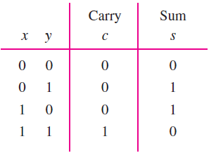
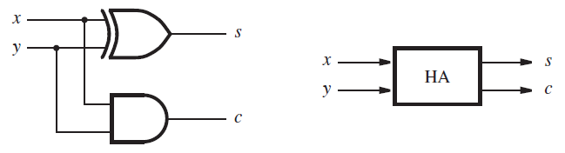
Half-adder
The addition operation can be defined in the form of a truth table as,
The sum bit s is the XOR function. The carry c is the AND function of inputs x and y.
A circuit realization of these functions is shown in Figure.
This circuit, which implements the addition of only two bits, is called a half-adder (HA).

